Slide 1

Quark Publishing Platform
An Introduction to Platform Scalability

Slide 2

Overview
Considerations
Recommendations
Proposed architecture
Wrap-up

Slide 3
Considerations
1

Slide 4

System Requirements Key Factors
Platform performance
Indexing (previews)
On save
On demand
Automation scope
Publishing requests per day
Messaging
Watched queries
Limited resources
Hardware
Network

Slide 5




System Requirements Key Factors
QuarkXPress Server performance
Rendered page count
Number of raster images rendered
Number of vector images rendered
Number of images with transparency
Number of tables
Number of tables which span across multiple pages

Slide 6



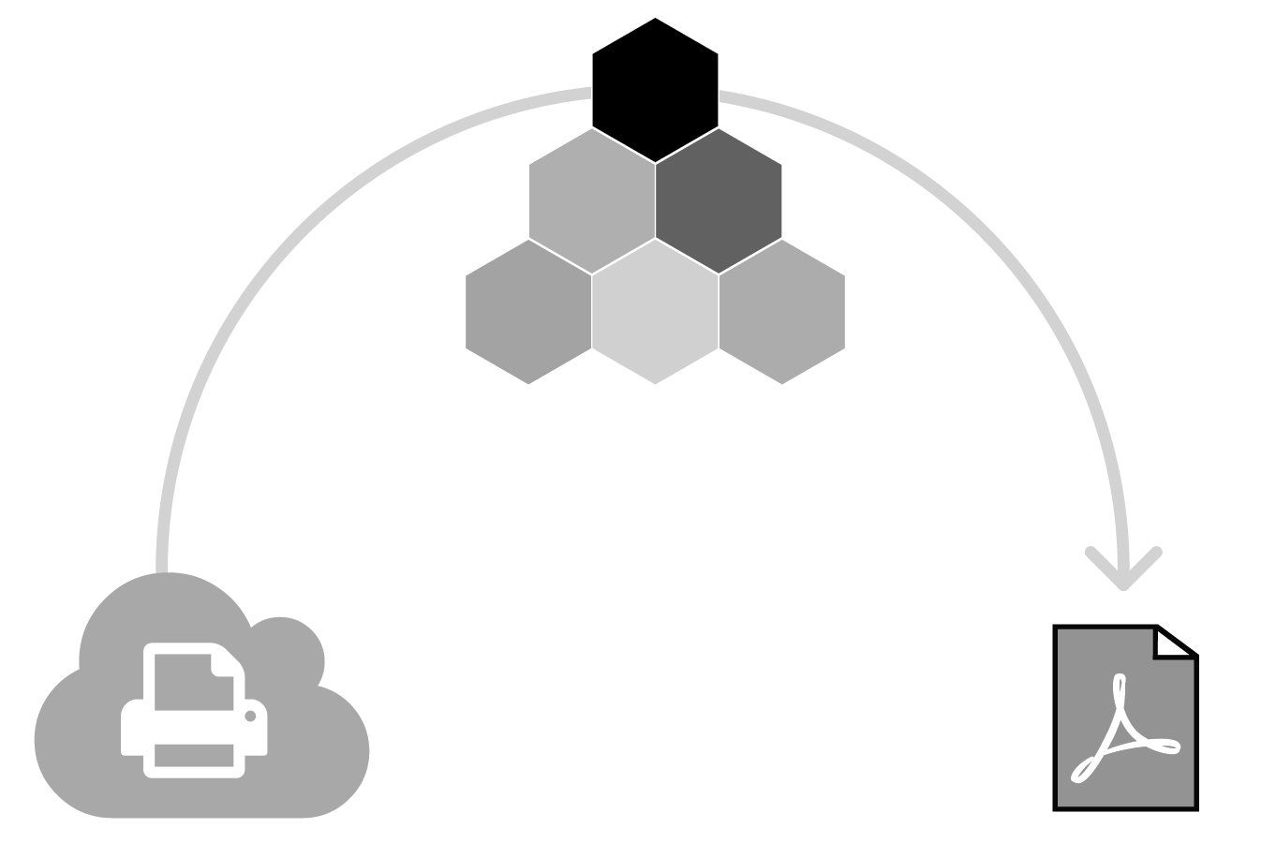

System Requirements Key Factors
QuarkXPress Server performance (con’t)
Number of landscape pages
Layout richness: low, medium, high
PDF output styles
Number & size of interactive artifacts
Number & frequency of live preview requests (JPEG/PDF)
Number of check-ins = re-indexing

Slide 7
Recommendations
2

Slide 8
System Requirements Business Analysis
Assumptions
Provide horizontally scalable architecture
Plan for upper limit of users
Use staged systems: dev to test, test to prod
Extrapolate from available, observed patterns
For example:
Determine an average number of daily/hourly QXPS requests per user
Determine the average number of concurrent and total Platform users
Determine how much of the load is automation
How much are the numbers growing?

Slide 9
System Requirements Business Analysis
More assumptions
Maximize hardware investment for longevity
Plan for growth at a factor of x5 or x10
200 x 5 = 1000 users
1,000 x 5 = 5,000 requests / day (on average)
Account for new scope
Interfaces with other systems
User and automated activity competing for resources
Growth by business acquisitions and/or migration of legacy publication systems
Plan for disruptive, digital transformation and future opportunities arising from analytics

Slide 10
System Requirements Recommendations
Go big, avoid making changes later
Optimize configuration to isolate resources, for example:
Dedicated database server (1)
Dedicated Platform application servers (2)
Dedicated QXPS servers (2, each with 8 sub-renderers)
One for automation
One for requests generated by humans
Plan for scaling horizontally
Plan for scaling out with load balancers

Slide 11
Proposed Architecture
3

Slide 12


System Architecture

Slide 13
Specific Hardware Option Higher-volume
Platform Application Servers
2x Application Servers
2x Intel Xeon 2.1GHz CPUs, each with 8-cores (16 total)
64GB RAM
Rendering Application Servers
2x QXPS Servers (each with 8 sub-renderers)
2x Intel Xeon 2.1GHz CPUs, each with 8-cores (16 total)
64GB RAM
Database Server
3x Intel Xeon 2.1GHz CPUs, each with 8-cores (24 total)
32GB RAM

Slide 14
Wrap-up
4

Slide 15
Wrap-up
Your success is our success
Move customers to production
Quark Services & 3rd party partners
Balance must-have features for many customers
Keep production systems active
Customer Rapid Response
Enterprise Support
Scale production implementations
We listen: customer plans influence priorities
Engage as partners: feedback = continuous dialogue
Questions?
Notes:
Every business struggles to manage their content better. Enterprise champions who drive solutions across the organization are remembered for their vision.

